Slide 1
MolSim WS 23/24
Sheet 2
Collision of two bodies
Group C [Manuel, Tobias, Daniel]
11/17/2023

Slide 2
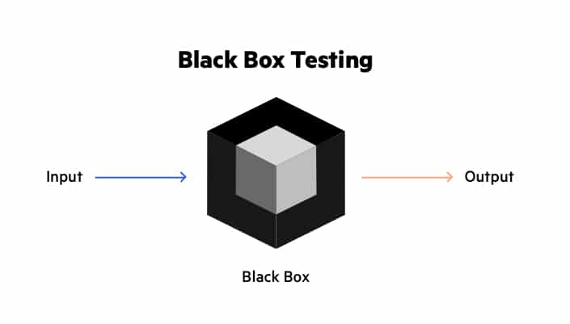
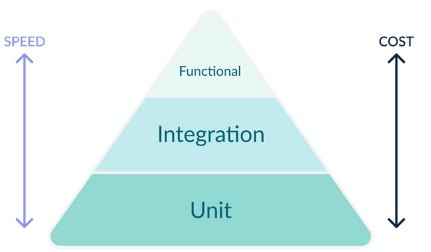
Unit tests
Important testing principles
independent components
independent parameters
Different testing goals
Components vs (Sub-)Systems
Functionality vs format

Slide 3
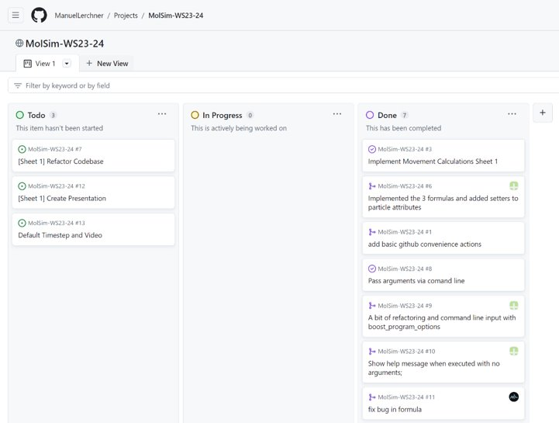
Github Project Management
Task Planning via Github
Kanban Board View
Easy way to see open issues

Slide 4

Github Issues
We organize open tasks in issues
Issues can be assigned to persons
Everyone can work in parallel
Hopefully not many merge conflicts
Creation of pull requests to protect the master branch

Slide 5
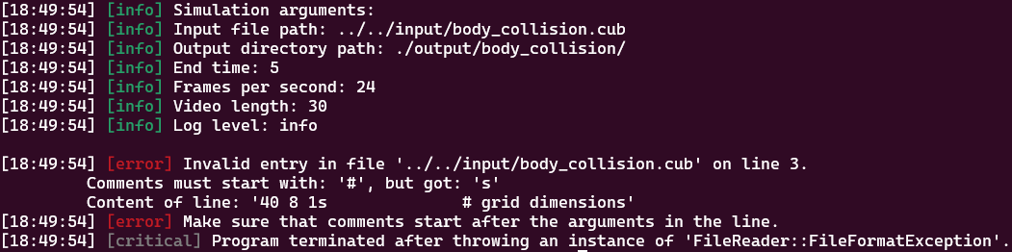
Logging
Integration of the spdlog library
Prettier and distinguishable output for different information
User selectable log-levels

Slide 6
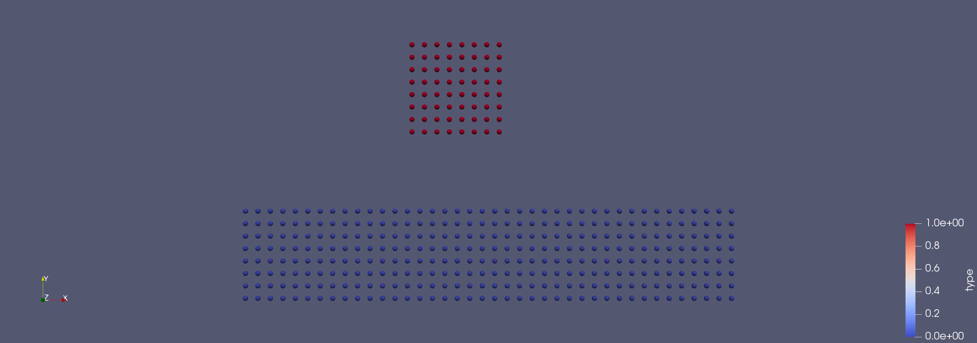
Simulation 1

Slide 7
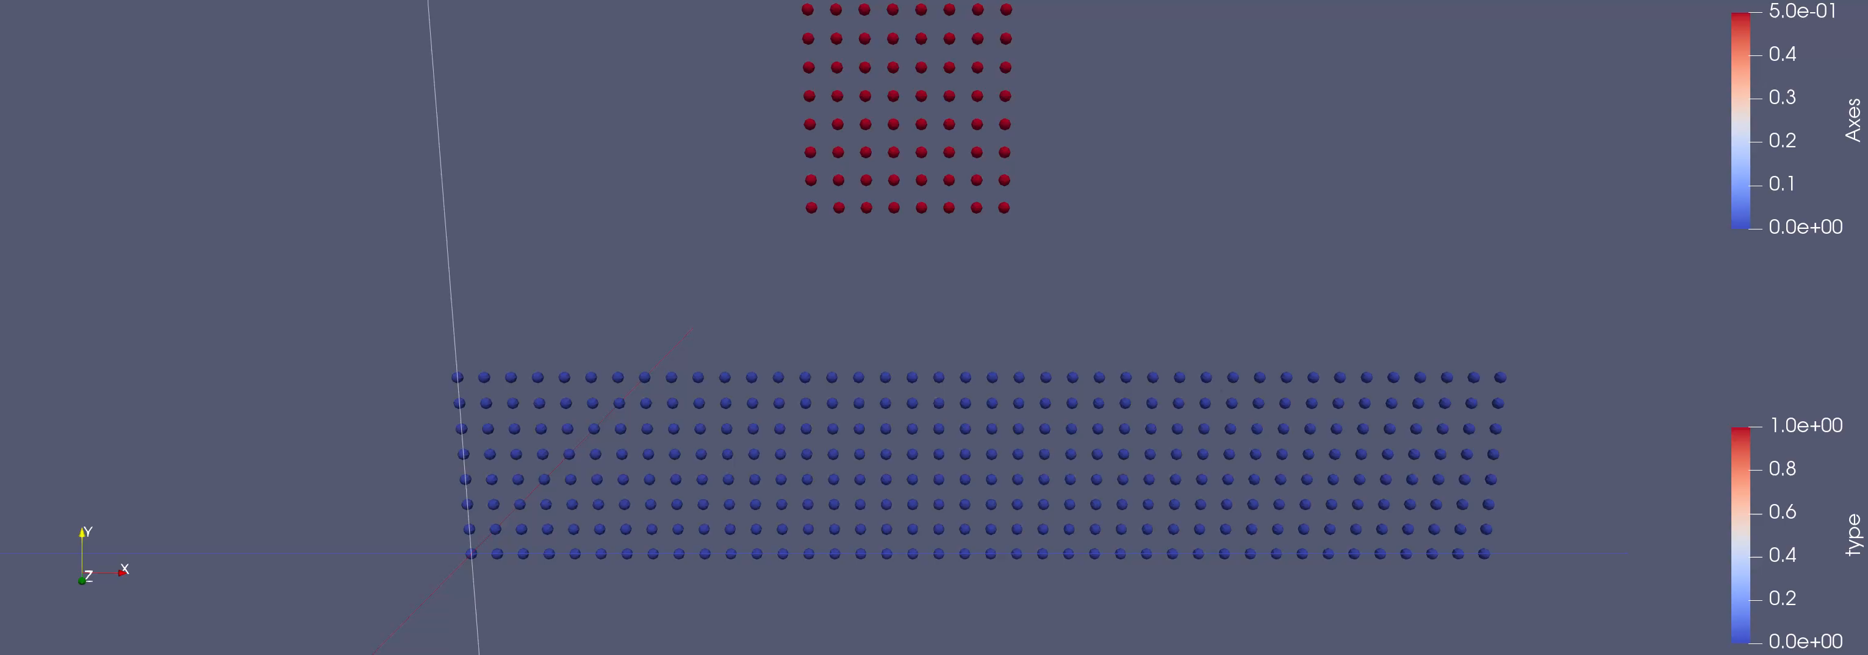
Simulation 1

Slide 8
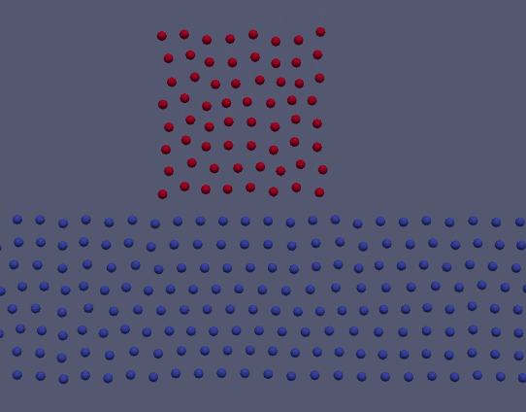
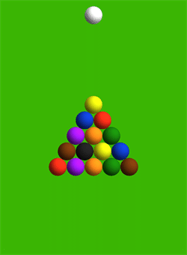
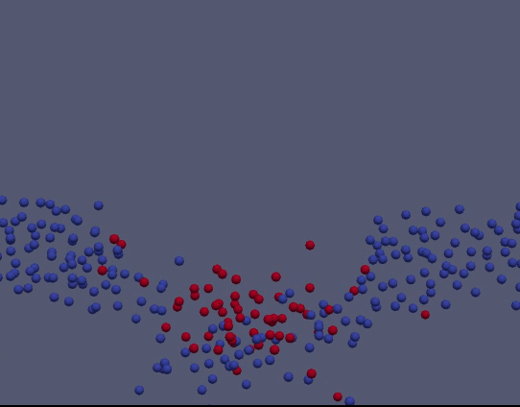
Simulation 1
Observation 1:
Particles scatter on impact
Red particles transfer momentum to a few of the blue ones
Particles move together according to newtons 1st law
Similar processes:
Billiard ball colliding

Slide 9
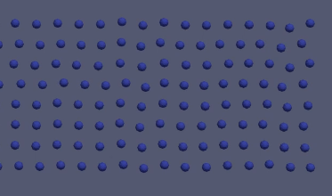
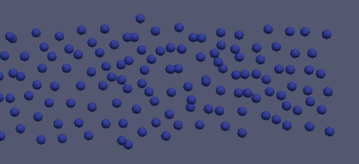
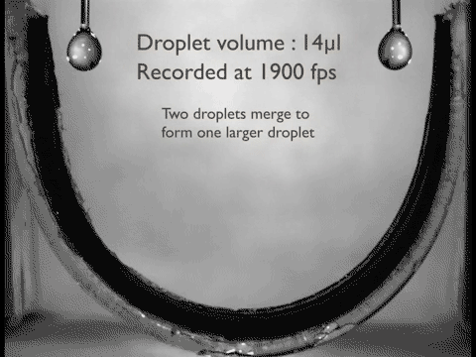
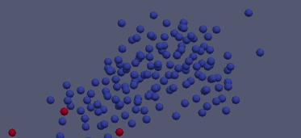
Simulation 1 + 2
Observation 2:
The cuboids deform and seem to collapse a little even before collision
Untouched portions of blue cuboid still deformed
-> test with second simulation: cube without initial velocity should become sphere-shaped
Similar processes:
Forming of water drops
Forming of (round) planets due to gravity

Slide 10
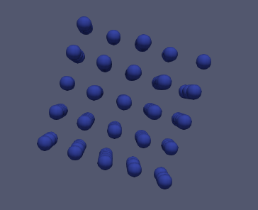
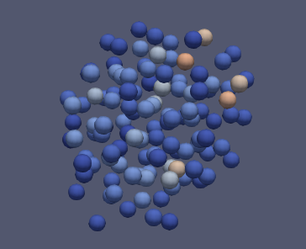
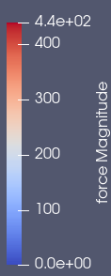
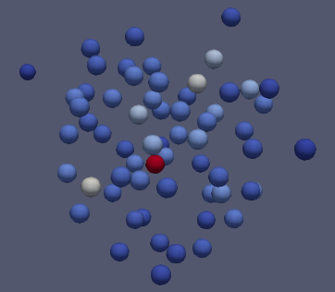
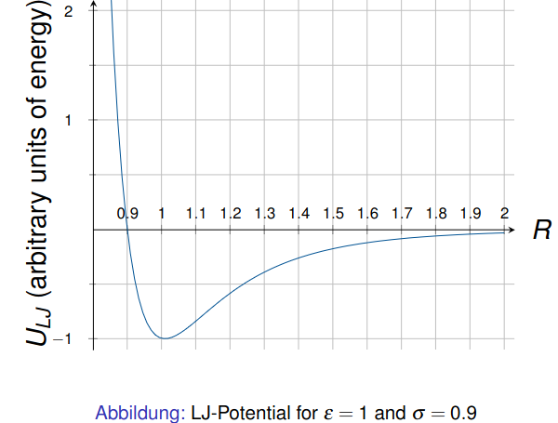
Simulation 2
Observations:
Order
Particles clump together
Particles that get too close drift apart again
-> asymmetry of Lennard-Jones-Potential

Slide 11
Summary of cool things
We created a few tests
We continued and marginally extended our GitHub workflow
We simulated a bunch of particles
We drew a pretty particle collision
We drew an even prettier particle collision with a moving camera

Slide 12
References
Unit testing bild: https://codefresh.io/learn/unit-testing/ 2
Black box testing bild: https://www.imperva.com/learn/application-security/black-box-testing/
Billiard balls colliding gif: https://community.wolfram.com/groups/-/m/t/418720
Water droplet gif: https://popperfont.net/2012/08/20/superhydrophobic-carbon-nanotube-water-droplet-bouncing-gif-goodness/

